Slide 1
Capstone Project
Mobile Price Range Prediction - Shrikanth Ravi -Ankit Raj

Slide 2
Problem Statement
Based on given features
Analyze the features
Predict the price range of mobile

Slide 3
Information Available
Number of Independent features- 19
List of Features:
Battery_power – in mAh
Blue- Bluetooh (yes /no)
Clock_speed- execution speed of microprocessor.
Dual_sim- (yes/no)
Fc- Front camera in mega pixels.
Four_g- (yes/no)
Int_memory- internal memory in Gigabytes.
M_dep- Mobile Depth in cm.
Mobile_wt- weight of mobile.
N_cores- number of processors.

Slide 4
Information Available
Pc- Primary Camera mega pixels.
Px_height- Pixel Resolution height.
Px_width- Pixel Resolution width.
Ram- in megabytes.
Sc_h- Screen Height of Mobile in cm.
Sc_w- Screen Width of Mobile in cm.
Talk_time- duration full charge battery lasts.
Three_g- (yes/no)
Touch_screen-(yes/no)
Wifi- (yes/no)

Slide 5
Target Variable
Price Range
0 (low cost) 1 (medium cost) 2 (high cost) 3 ( very high cost)

Slide 6
Data Preprocessing
Number of Rows- 2000
Number of columns- 21
Null values- no none value
Data type- integer and float
Data Balanced – Yes, all four classes equally distributed in data set
Continuous Variables- battery_power, clock_speed, int_memory, m_dep, mobile_wt, px_height, px_width, ram, sc_h, sc_w, talk_time, n_cores, pc

Slide 7
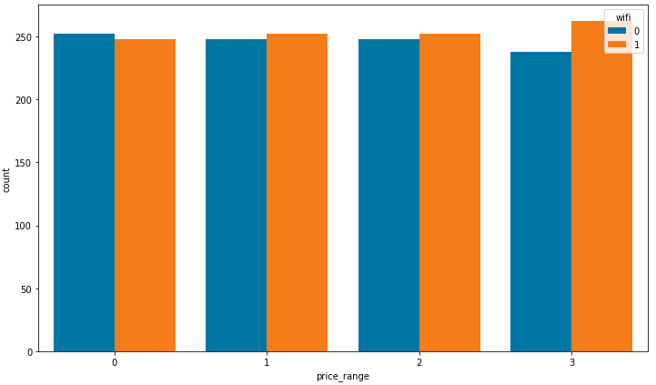
EDA
Wifi- price range 0 has more non wifi device. In rest of the price range wifi enabled device is more.

Slide 8
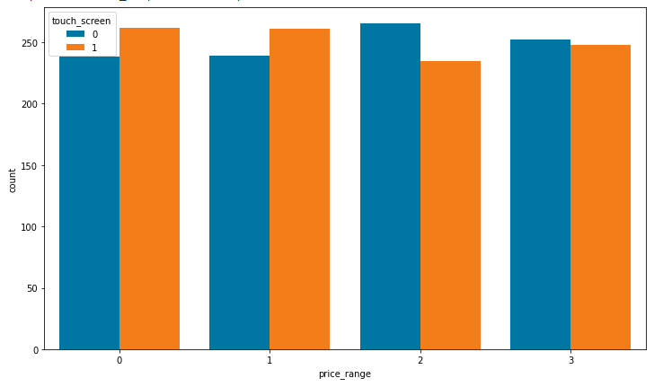
EDA
Touch Screen- It is not a desirable requirement with increase in price range.

Slide 9
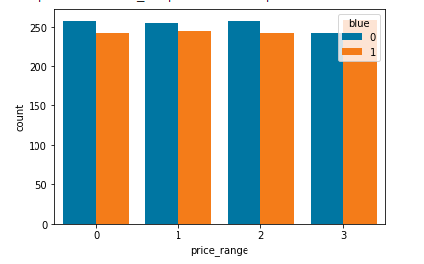
EDA
Bluetooh- Price range 3 (very high cost) has more Bluetooth enabled devices.

Slide 10
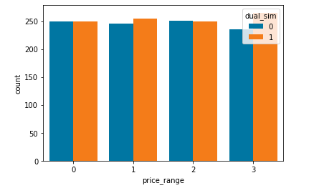
EDA
Dual sim- more desirable for medium and high cost.

Slide 11
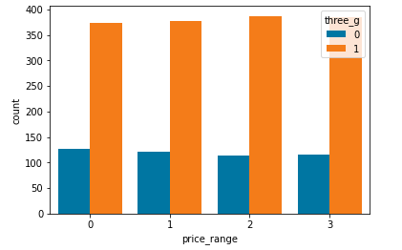
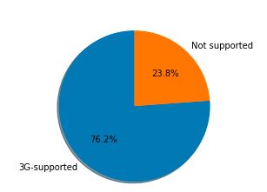
EDA
three_g- it is a most desirable feature for mobile irrespective of price range. One can say that data might be of time when 3G swap the market.

Slide 12
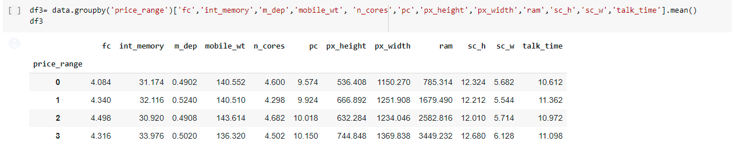
EDA of Continuous Variable
Mean of all continuous variables to know its trend in all price ranges.

Slide 13
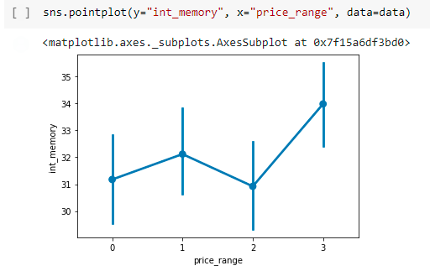
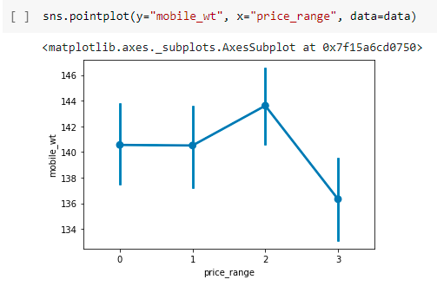
EDA of Continuous Variables
Graphical representation.

Slide 14
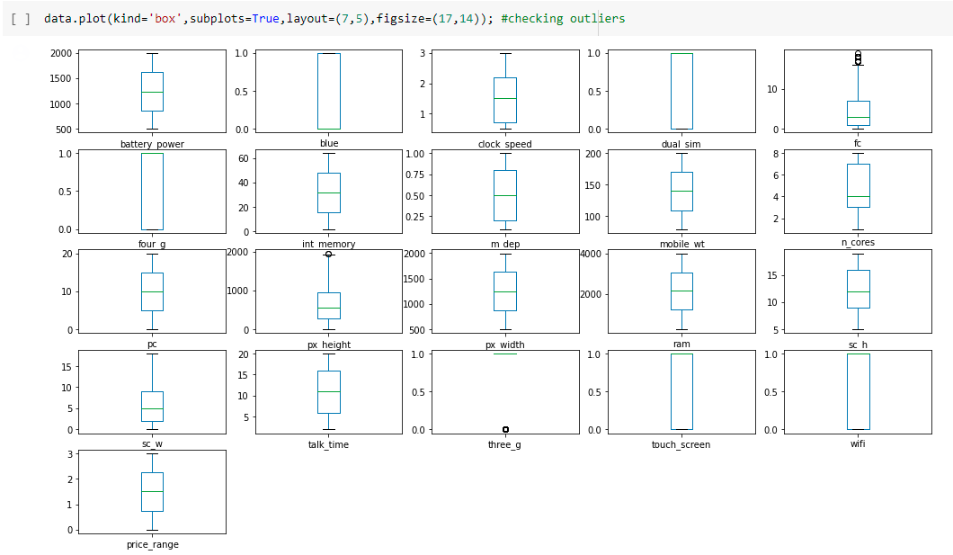
Outlier Treatment
Before Outlier Removal

Slide 15
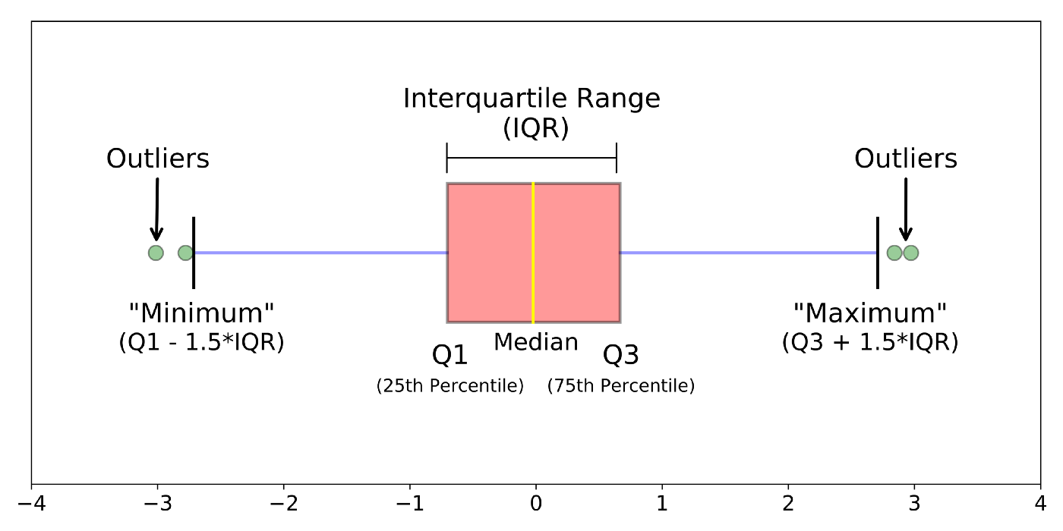
Outlier Treatment
Method used- IQR method

Slide 16
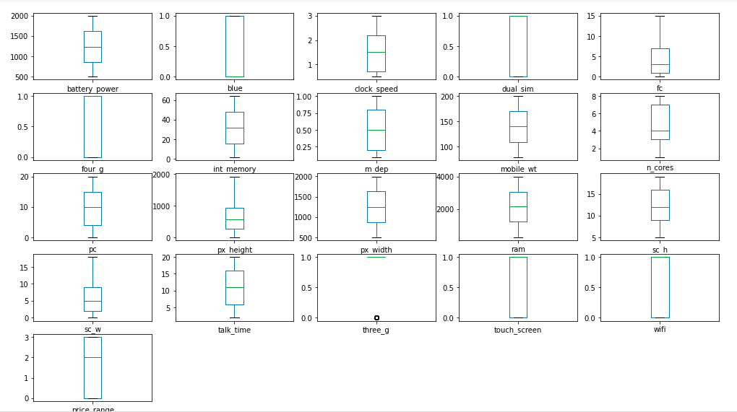
Outlier Treatment
After removal of Outliers.

Slide 17
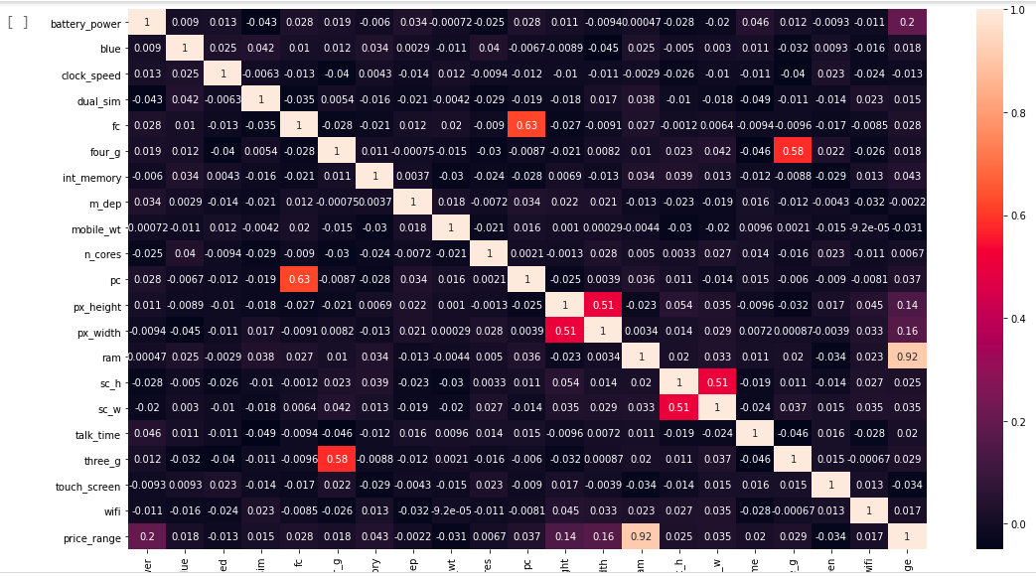
Relationship Among All Features
Correlation test was ran to see relationship among features. No significant relation was observed. Hence none of the features were dropped.

Slide 18
Model Selection
There was no form was observed among features and target variable. So, Ensemble technique was used. Random Forest and XG Boost. To bolster it logistic regression was also implemented but as expected very poor performance was observed.
XGBoost gave slightly better result when compared its evaluation metrics with Random Forest. Hence, we will choose XGBoost as our best model.

Slide 19
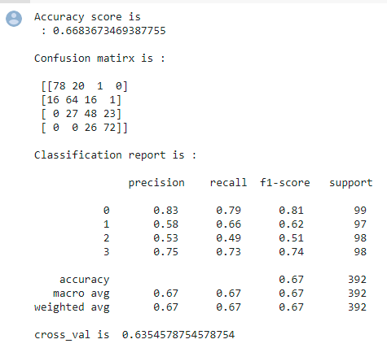
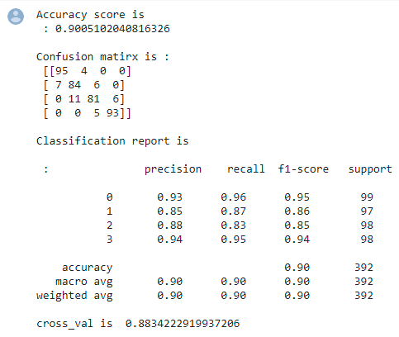
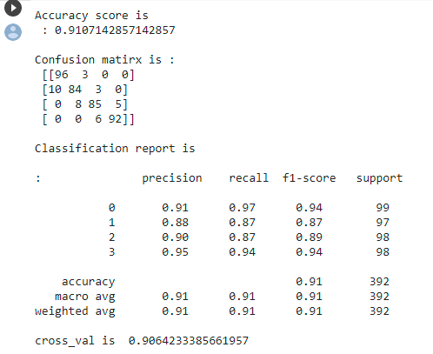
Model Comparison
Logistic Regression Random Forest Classifier XG Boost Classifier

Slide 20
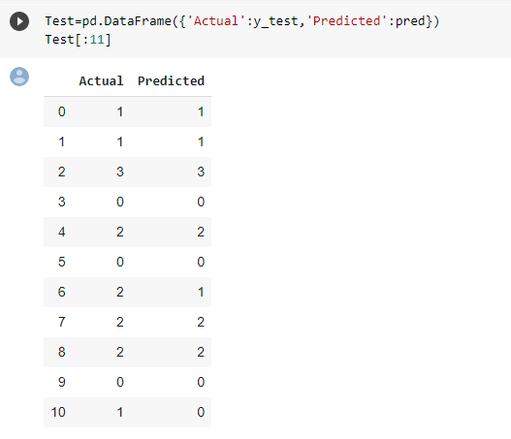
Conclusion
Our Model was able predict the values using XG BOOST with an accuracy of 91%

